Slide 1
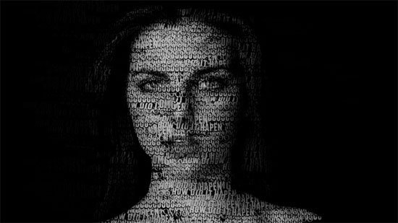
IMAGE CAPTIONING
LSTM APPLICATIONS

Slide 2

VIDEO CAPTIONING
MOTIVATIONS
Globally, it is estimated that approximately 1.3 billion people live with some form of distance or near vision impairment. With regards to distance vision, 188.5 million have mild vision impairment, 217 million have moderate to severe vision impairment, and 36 million people are blind.

Slide 3
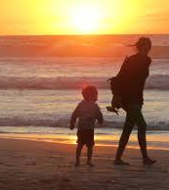
IMAGE
CAPTIONING
Perception with respect to machines

Slide 4
SHOW, ATTEND AND TELL
NEURAL IMAGE CAPTION
GENERATION WITH VISUAL ATTENTION
Kelvin Xu - Jimmy Lei Ba - Ryan Kiros - Kyunghyun Cho - Aaron Courville - Ruslan Salakhutdinov - Richard S. Zemel - Yoshua Bengio - 2016
Attention Based Model learns to describe image contents
Deterministic Training using Standard Propagation
Learn to gaze on Salient Object

Slide 5
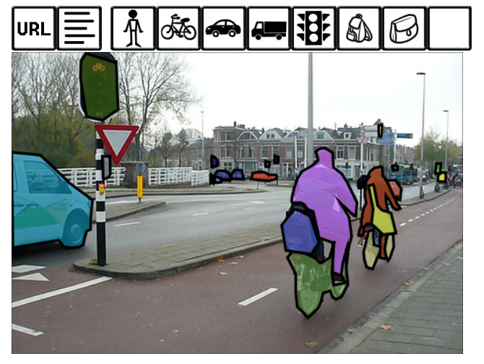
SHOW ATTEND & TELL
DATASET
COCO – Common Objects in Context
COCO Image Previewing

Slide 6
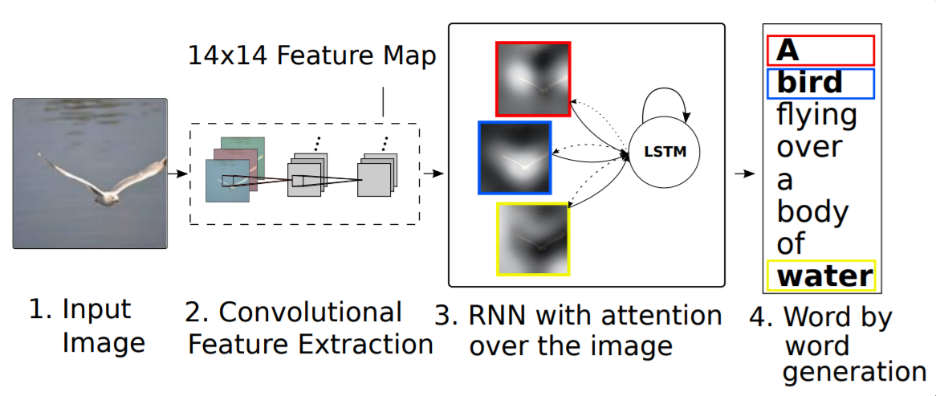
SHOW ATTEND & TELL
OVERVIEW
Figure 1 – Model learning word/image alignment

Slide 7
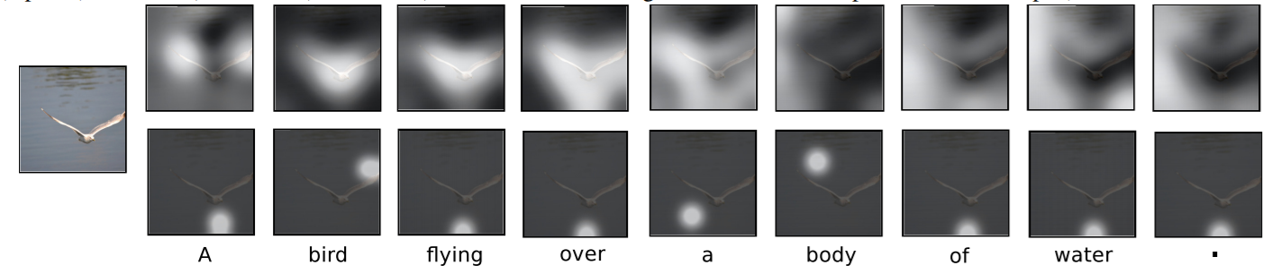
SHOW ATTEND & TELL
CONTRIBUTIONS
Two attention-based image caption generators under a common framework.
A “soft” deterministic attention mechanism trainable by standard back-propagation methods.
A “hard” stochastic attention mechanism trainable by maximizing an approximate variational lower bound
Figure 2 – Soft (top) & Hard (bottom) Attention models

Slide 8
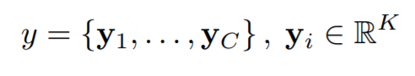
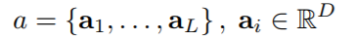
SHOW ATTEND & TELL
IMPLEMENTATION
ENCODER - CONVOLUTIONAL FEATURES
Model takes a single raw image and generates a caption y encoded as a sequence of 1-of-K encoded words
Extract a set of feature vectors (annotations vectors)

Slide 9
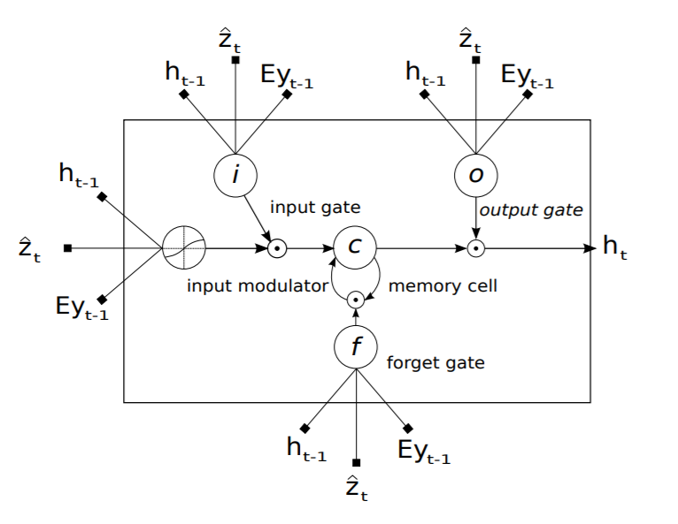
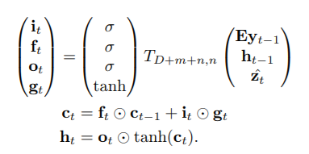
SHOW ATTEND & TELL
IMPLEMENTATION
DECODER - LONG SHORT-TERM MEMORY NETWORK
Produces a caption by generating one word at every time step conditioned on a context vector
Figure 3 – LSTM Cell

Slide 10
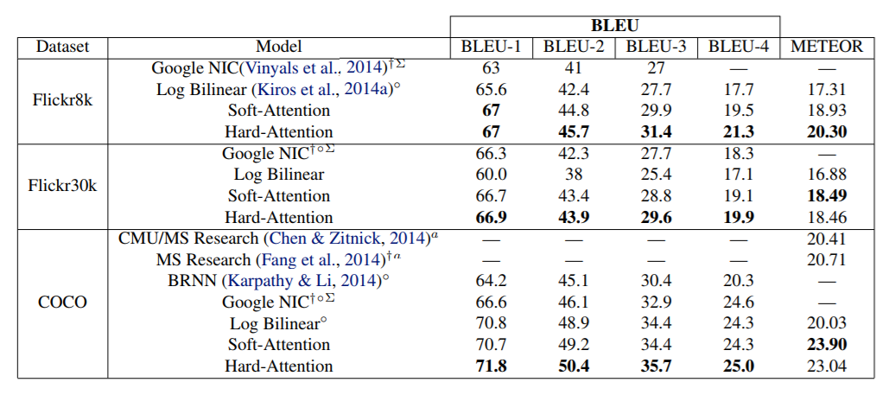
SHOW ATTEND & TELL
RESULTS
Table 1 – Soft & Hard Attention models results

Slide 11
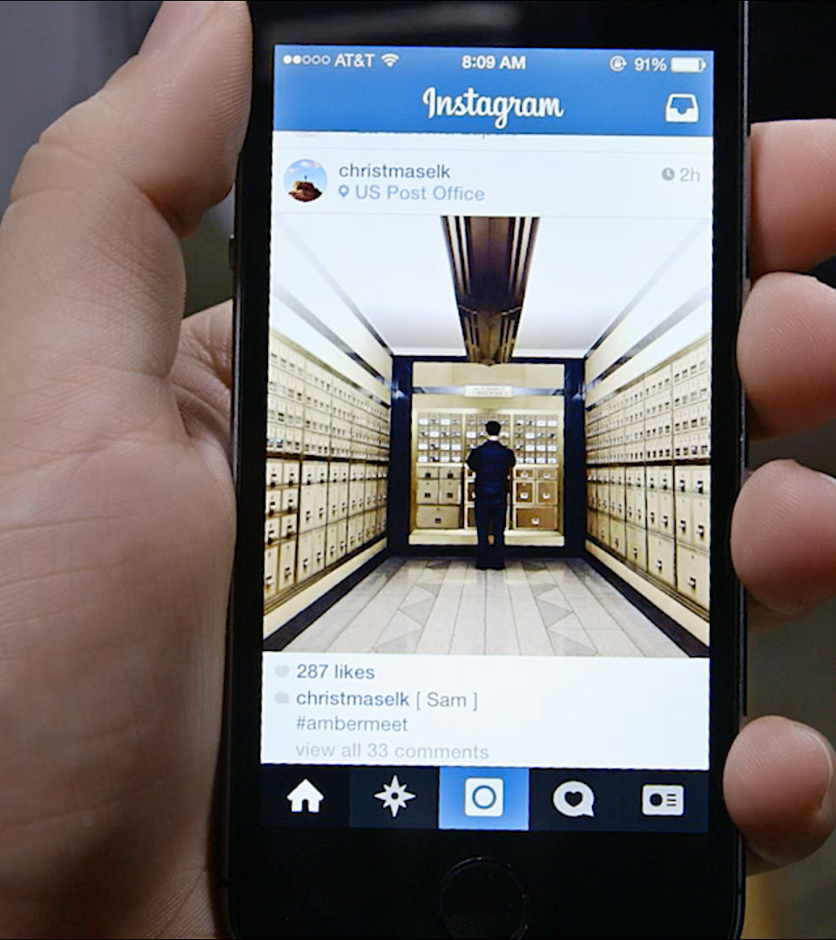
PERSONALIZED
IMAGE
CAPTIONING
Descriptive captioning with prior knowledge

Slide 12
ATTEND TO YOU
PERSONALIZED IMAGE CAPTIONING
WITH CONTEXT SEQUENCE MEMORY NETWORKS
Cesc Chunseong Park - Byeongchang Kim -Gunhee Kim - 2017
Descriptive sentence with prior knowledge: Users vocabulary in previous documents
Context Sequence Memory Network (CSMN)

Slide 13
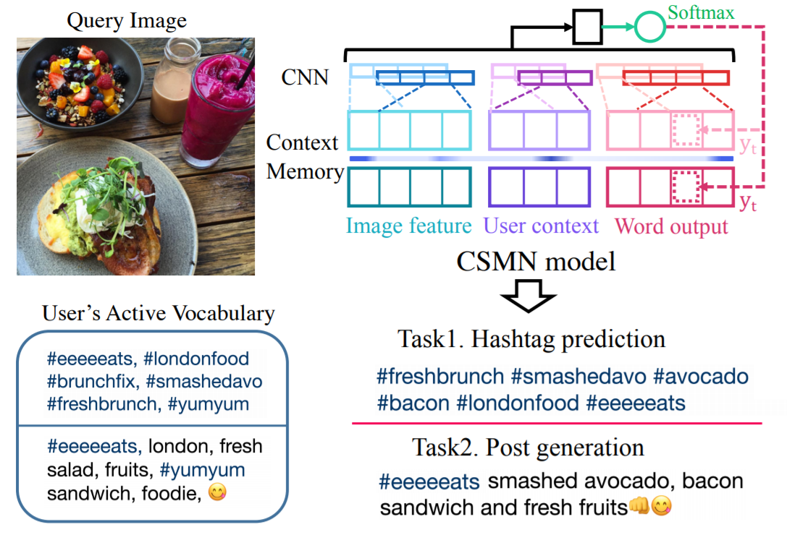
ATTEND TO YOU
OVERVIEW
Figure 4 – Personalized image captioning with an Instagram example

Slide 14
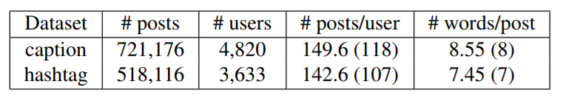
ATTEND TO YOU
DATASET
INSTAGRAM POSTS
270 search keys – 10 most common hashtags over 27 categories (e.g. food, styles)
3.5M posts from 18k users
FILTERING
English only, links removal, remove user bias (> 50 posts) & limit post lengths (irrelevance)
720k captions & 520k hashtags
PREPROCESSING
Vocabularies building, frequency based, 40k captions, 60k hastags

Slide 15
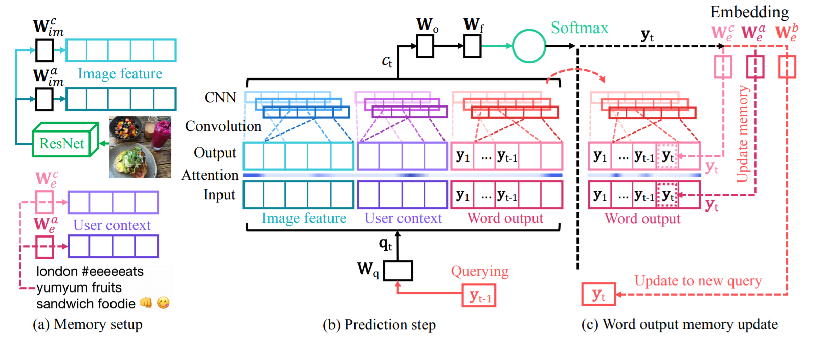
ATTEND TO YOU
IMPLEMENTATION
Figure 5 – Context sequence memory network (CSMN) Model

Slide 16
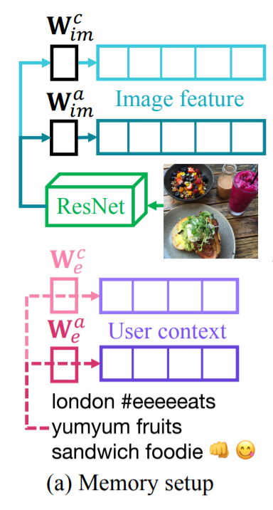
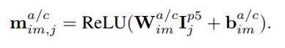
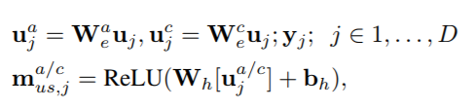
ATTEND TO YOU
CONTEXT MEMORY
IMAGE MEMORY
ResNet 101 pretrained on the ImageNet 2012 dataset
(7 × 7) feature maps of res5c layer (49 cells) model exploits spatial attention
pool5 feature (1 cell) single memory focus
USER CONTEXT MEMORY
User’s most frequent words from previous posts (D)
Uses frequency-inverse document frequency (TF-IDF)
Results in ignoring too general terms that many users commonly use

Slide 17
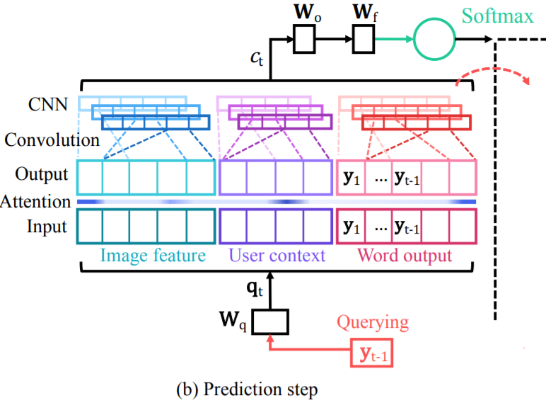
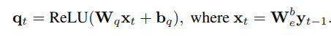
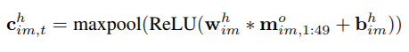
ATTEND TO YOU
STATE-BASED SEQUENCE GENERATION
Approach does not involve any RNN module
Sequentially store all previously generated words into the memory
=> Enables to predict each output word by selectively attending on
the combinations of all previous words, image regions, and user context
Define a set of three filters whose depth is 300 by changing window sizes h = [3, 4, 5]
Separately apply a single convolutional layer and max-pooling layer to each memory type
We obtain c(im,t) by concatenating c(h,im,t) from h = 3 to 5

Slide 18
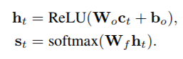
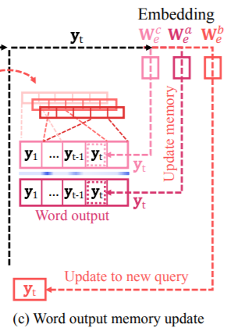
ATTEND TO YOU
WORD PREDICTION
The hidden state ht with a weight matrix Wo, compute the output probability st over vocabularies V by a softmax layer
Select the word that attains the highest probability

Slide 19
ATTEND TO YOU
TRAINING
Teacher forced learning, provide the correct memory state to predict next words
Softmax cross-entropy loss as the cost function for every time step predictions
minimizes the negative log likelihood from the estimated yt
Randomly initialize all the parameters with a uniform unit scaling of 1.0 factor
Apply mini-batch stochastic gradient descent
Use Adam optimizer with β2 = 0.9, β2 = 0.999 and ϵ = 1e − 08
To speed up training, using four GPUs for data parallelism, and setting a batch size as 200 for each GPU
Initial learning rate is set as 0.001
Every 5 epochs, divide the learning rate by 1.2 to gradually decrease it
Training over 20 epochs

Slide 20
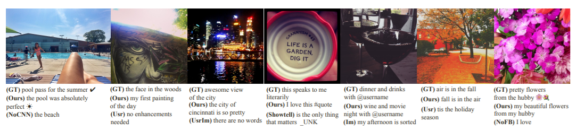
ATTEND TO YOU
RESULTS
CAPTIONS

Slide 21
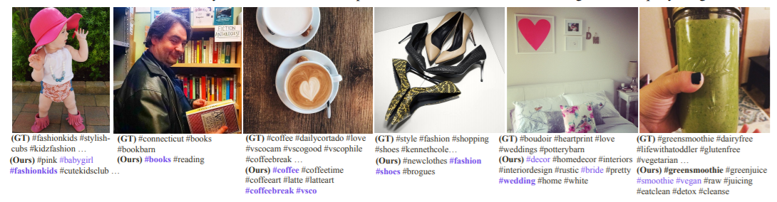
ATTEND TO YOU
RESULTS
HASHTAGS

Slide 22
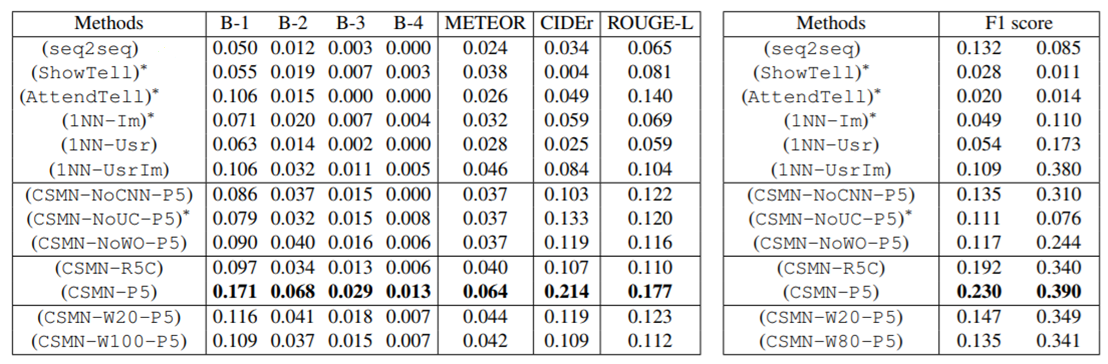
ATTEND TO YOU
RESULTS
COMPARISONS

Slide 23
THANK
YOU

